Slide 1
The Battle of Neighborhoods

Slide 2
Introduction/Business Problem
Asian cuisine is also very popular in the US, especially cities full of Asian immigrants, like the Silicon Valley in California.
Bubble tea is growing more and more popular, bubble tea stores often have a long queue in some hot business areas
This project aims to find the best location to open a business in a city in Silicon Valley, San Jose, CA
It’s important to know if it is profitable prior to launching any business, so this report will try to gather data about similar businesses in the neighborhood and potential customer distribution, competitors, etc.
The data can be used as part of a business plan to support making decision.

Slide 3
Data Descritpion
I will use Foursquare API to find venues:
For competitor study
Existing Bubble Tea shops around the neighborhoods in San Jose
Similar businesses around the neighborhoods in San Jose
For potential customer distribution study
Universities around the neighborhoods in San Jose
Companies around the neighborhoods in San Jose
Data visualization: I will use folium the map rendering library to visualize the venues

Slide 4
Methodology
City partitioning
Create a hexagonal grid of cells: offset every other row, and adjust vertical row spacing so that every cell center is equally distant from all it's neighbors.
All following data manipulations are operated against each of the cells
Get all bubble tea shops and coffee shops/Cafe in each area cell using the foursquare API (category approach)
Find potential customer spots in each area cell with foursquare API category approach (universities and companies)
Then we can calculate average number of customers (Entity of universities/companies)
Candidate place can be found among the areas that have highest customer/existing-biz ratio
Use heatmap to visualize the outstanding spots

Slide 5
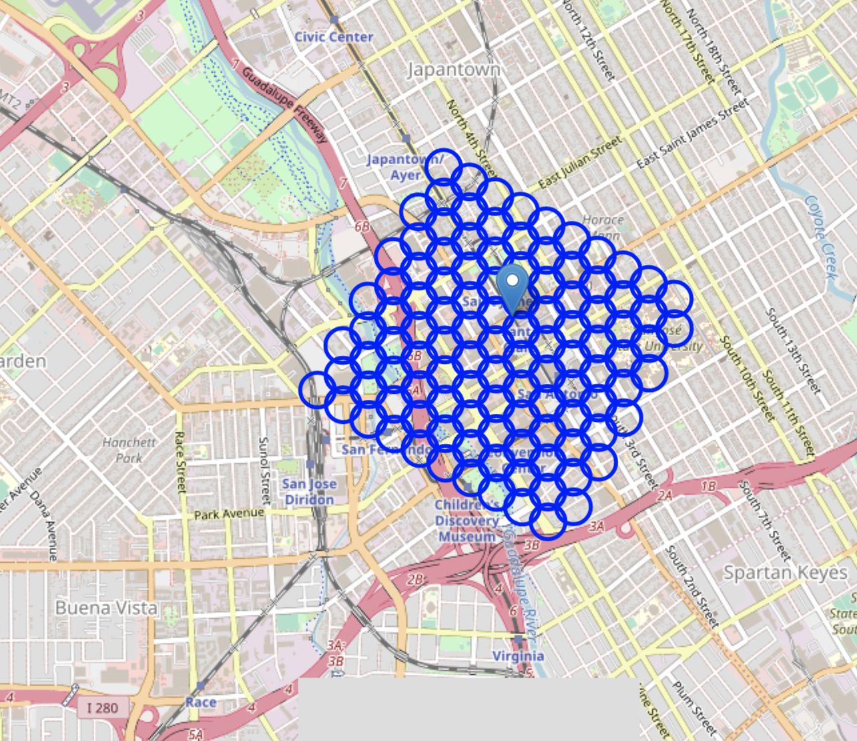
City partitioning

Slide 6
Exploratory Data Analysis
City partitioning to carve the city into small cells
Existing business situation: current bubble tea shops and other competitors (café, coffee shops)
Potential customer cluster situation (universities, companies)
Candidate areas that have profit potential
Visualization with Heatmap
Use Kmeans cluster approach to zoom to get the result set of location

Slide 7
Exploratory Data Analysis
Existing business situation
Total number of bubble tea shops: 32
Total number of other coffee shops or cafes: 0
Percentage of bubble tea shops in the tea/coffee biz: 100.00%

Slide 8
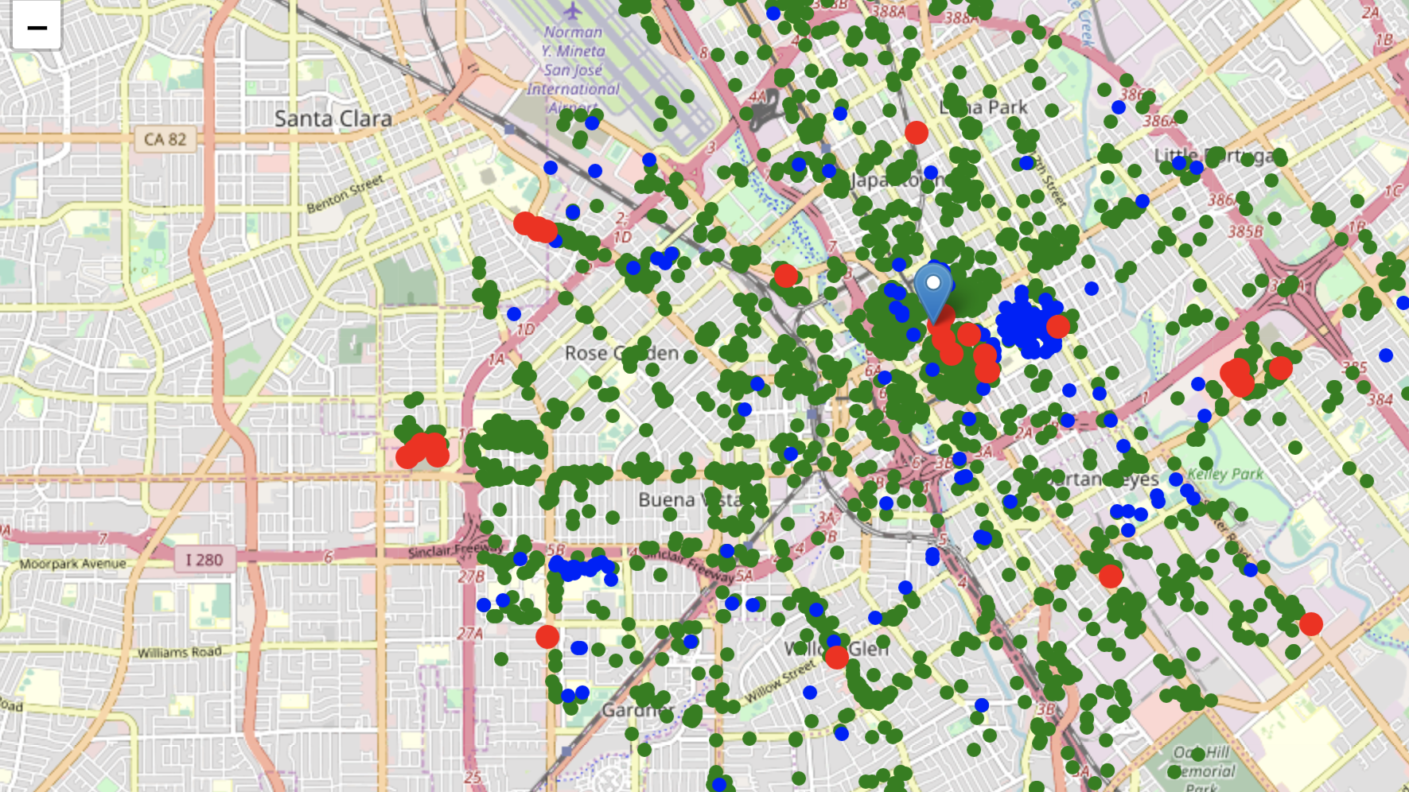
Exploratory Data Analysis
Existing business situation
Candidate areas that have profit potential are the ones have highest customer-density and least competitors

Slide 9
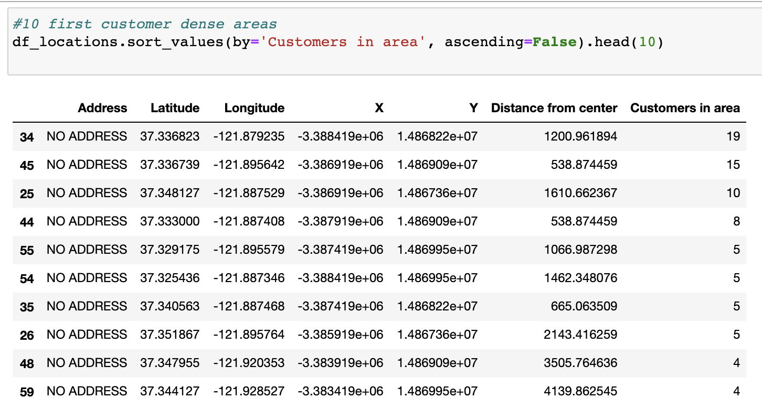
Exploratory Data Analysis
Then we list the top 10 customer dense areas

Slide 10
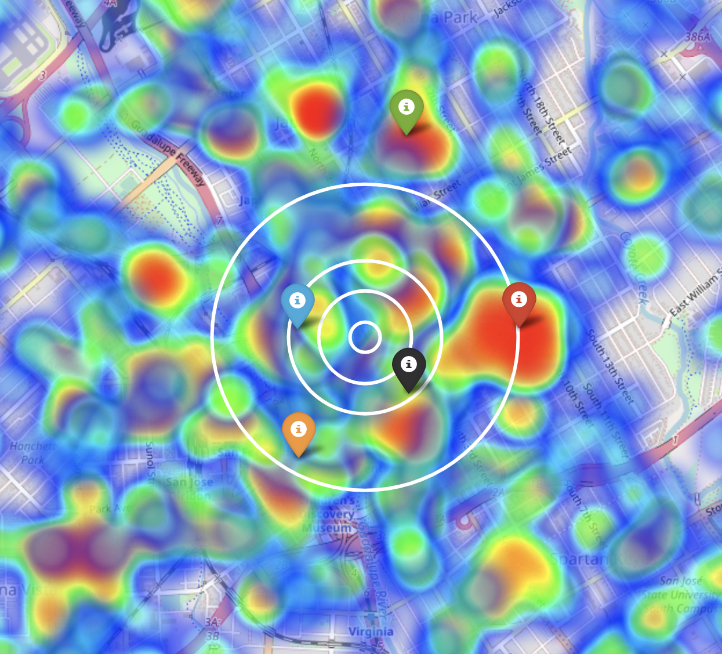
Exploratory Data Analysis
We can see that the customer-dense areas are all around the center of city San Jose

Slide 11
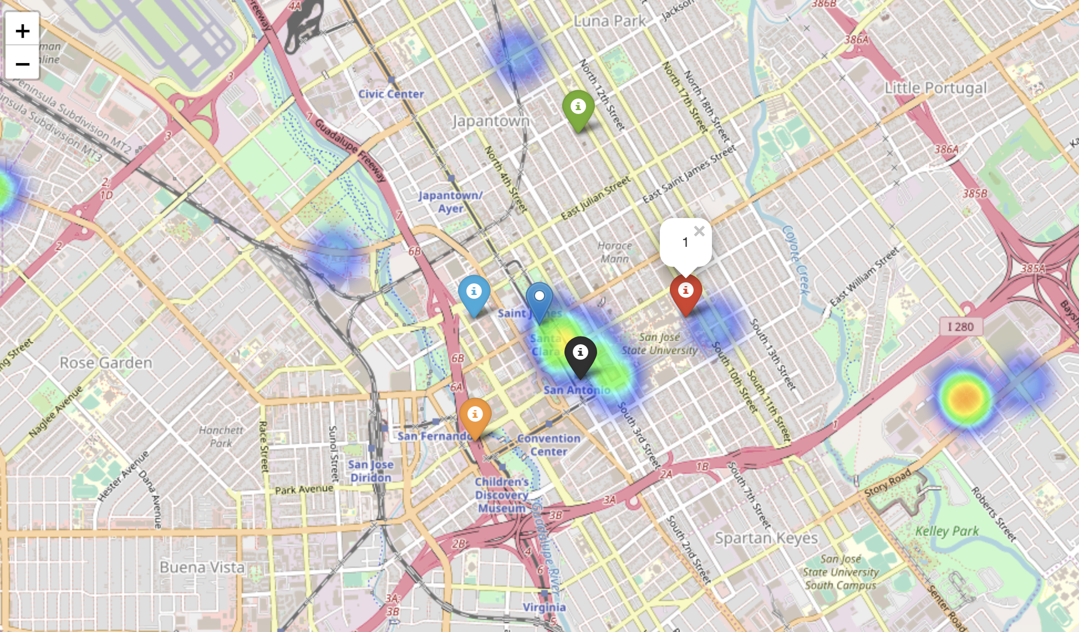
Exploratory Data Analysis
First, we list the top 10 customer dense areas
Visualize density of bubble tea shops with heatmap and use info-sign to mark the customer-dense locations

Slide 12
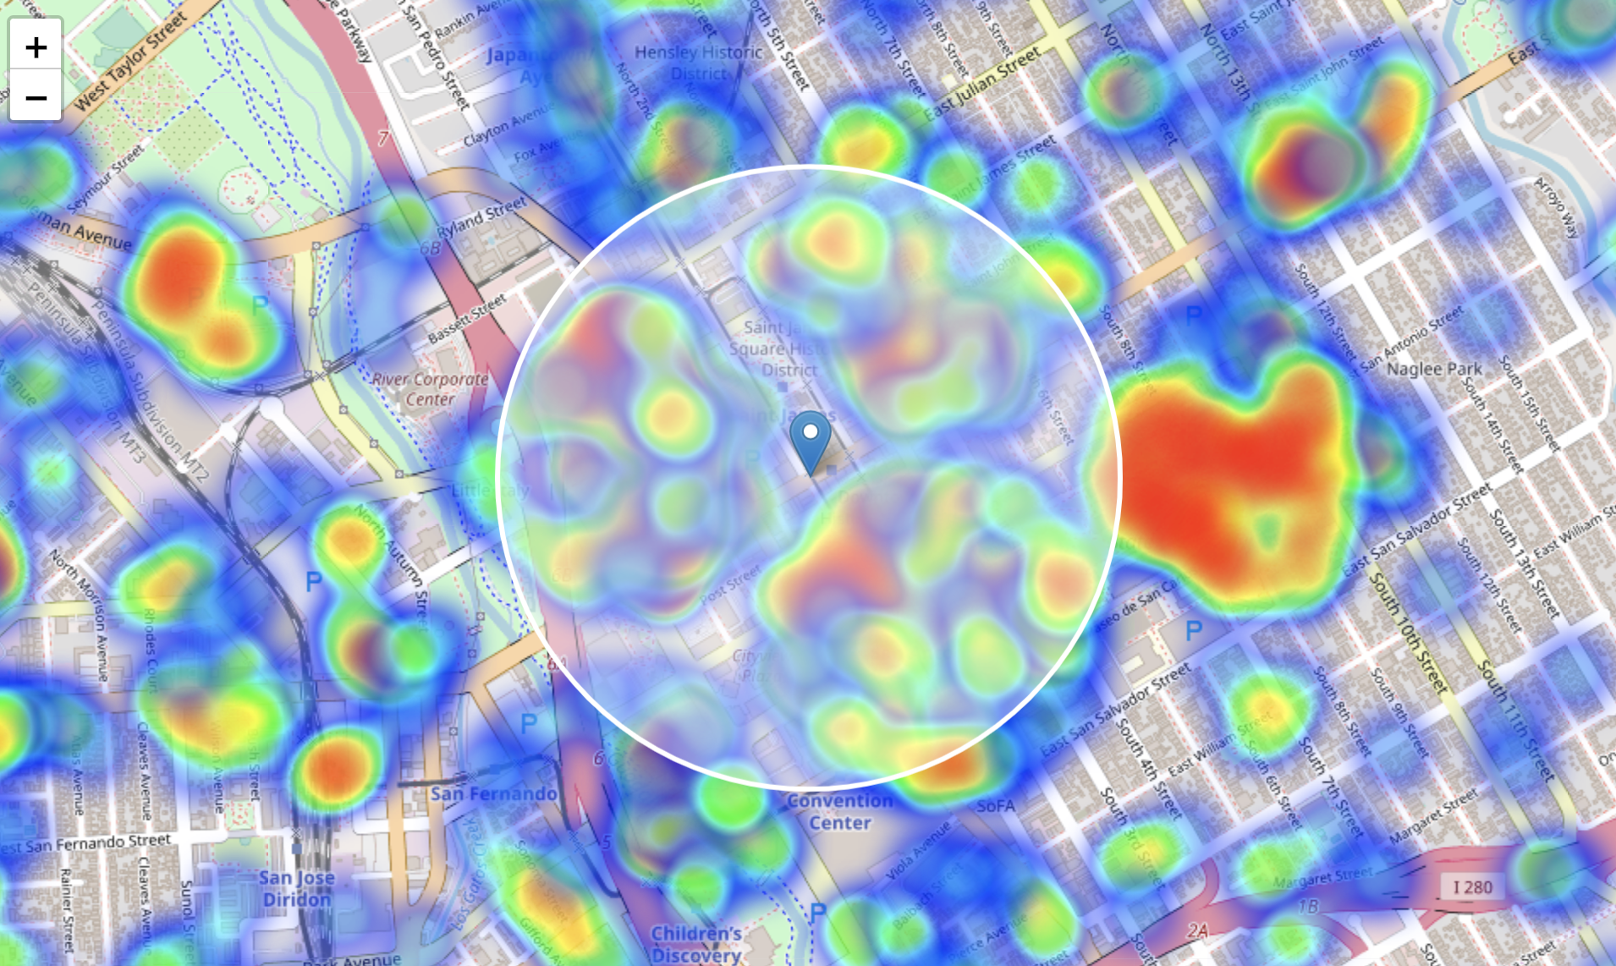
Result and Discussion
From prior exploration we can see that candidate location should still be focus around the center of the city
We zoom in to calculate all the data for each venue of the neighborhood
563 candidate neighborhood centers generated

Slide 13
Result and Discussion
Then among the 563 location candidates we calculate:
Number of bubble tea shops in the vicinity (radius = 150 meters)
Number of customers

Slide 14
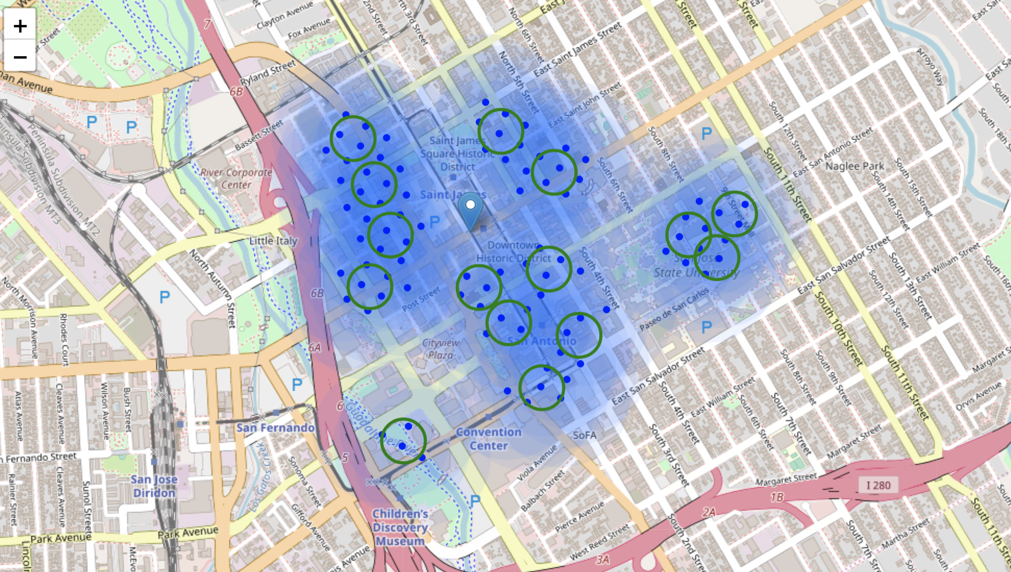
Result and Discussion
K means cluster create centers of zones containing good locations.
Heatmap The shaded areas indicate the clusters

Slide 15
Result and Discussion
On the right is a list of latitude/longitude of the cluster centers, which is our desired final result set.
User can easily find geocode converter on the internet to transform them into addresses, or use Google cloud API (It requires credit card information to create billing account, which I didn’t do)
[(-121.89537395222014, 37.339289648214105),
(-121.88731033435064, 37.3350177293404),
(-121.88039257430975, 37.33539209504962),
(-121.88928925207554, 37.33952741630228),
(-121.8933012401226, 37.32938658417022),
(-121.89383752411624, 37.33612939579999),
(-121.89468304830832, 37.33444102449878),
(-121.88760428815883, 37.331132309302276),
(-121.88896272037618, 37.33325632393298),
(-121.88709700301852, 37.3381863406691),
(-121.88155550076652, 37.336135699430486),
(-121.89018704724414, 37.33441517945734),
(-121.89450565474245, 37.337782937174474),
(-121.88607274905321, 37.332848052144),
(-121.8796683429025, 37.33682142543998)]

Slide 16
Conclusion and Future Direction
This analysis can be a good start for business feasibility evaluation, there must be other aspects to consider, the criteria we used for filtering may vary as we understand further about the business environment, which can not be fully covered in this study.
To be prudent, it is always be good to cross check data with other data sources.
To be more accurate, it could be possible to give a weight to customers, since younger people who work in a high-tech company have totally different consumer habits from the ones who work in a traditional industry
This project can be reused for other cities, other lines of businesses. User will need to adjust the parameters, values, criterias to fit their needs.

